Slide 1
2017 Stop, Question, and Frisk Data

Slide 2
NYC Stop Question Frisk
Implemented in 2002
97,296 incidents
Between 2003 and 2011 incidents increased dramatically
Maxing out at 685,724 in 2011
Since 2011 there has been a decrease in SQF incidents
Numbers have dropped dramatically after 2013

Slide 3
What are the trends in SQF data?

Slide 4
Questions
What is the relationship between overall SQF for NYC and SQF for the five individual boroughs?
What crimes are related to SQF?
Are there trends across days of the week, and months of the year for SQF?

Slide 5
Presenter 1

Slide 6
Presenter 1

Slide 7
Presenter 1

Slide 8
Presenter 1

Slide 9
Presenter 2

Slide 10
Presenter 2

Slide 11
Presenter 2

Slide 12
Presenter 2

Slide 13
Presenter 3

Slide 14
Presenter 3

Slide 15
Presenter 3

Slide 16
Presenter 3

Slide 17
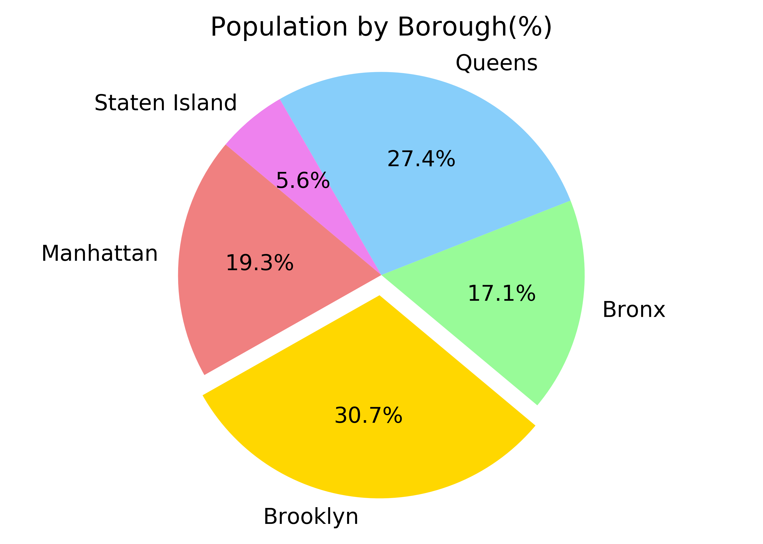
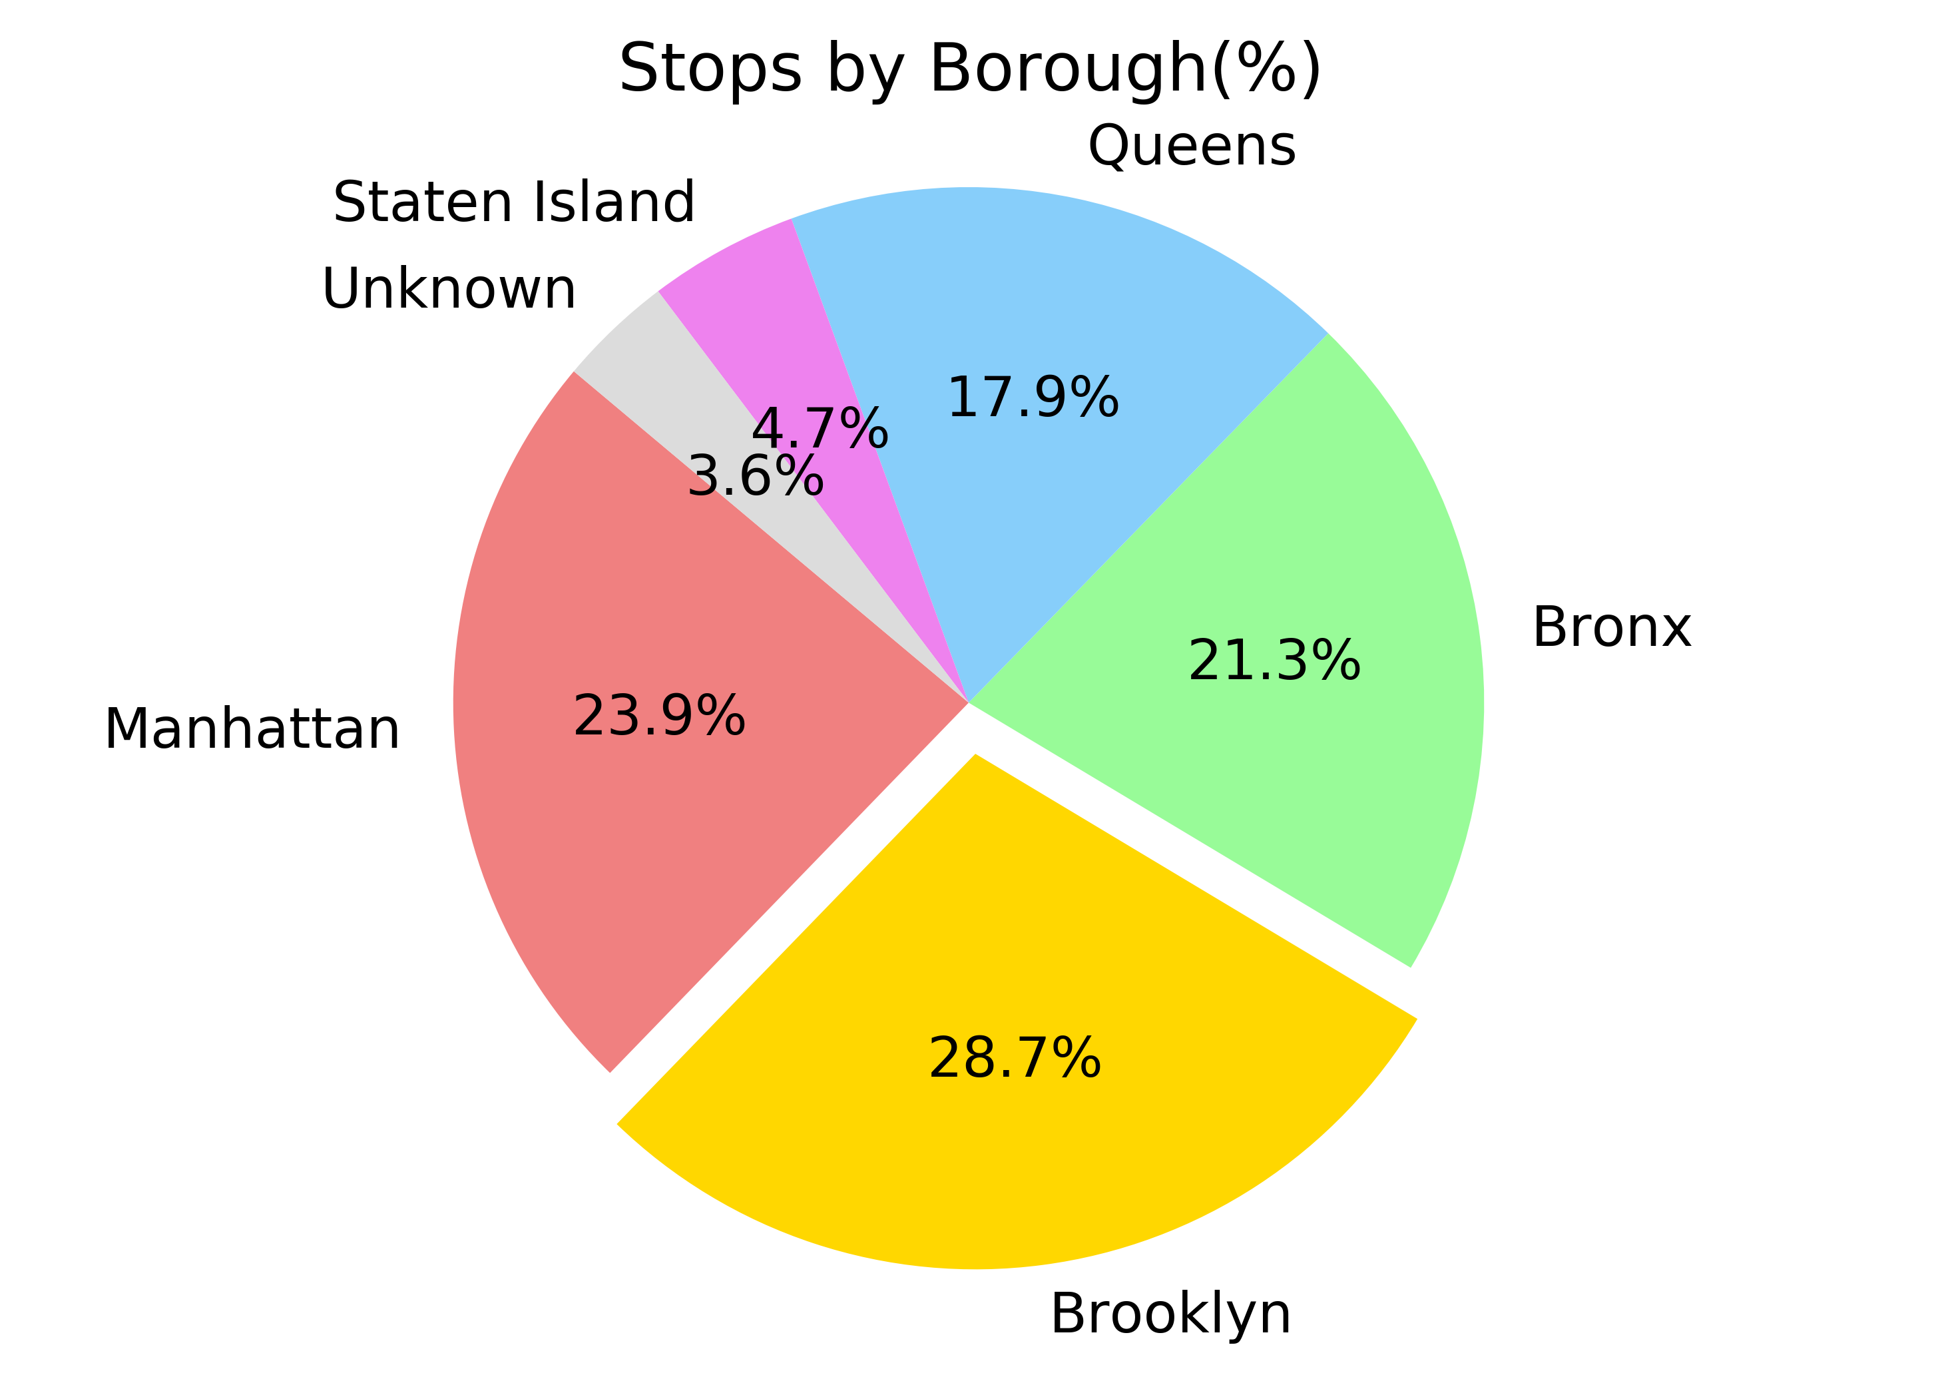
Presenter 4

Slide 18
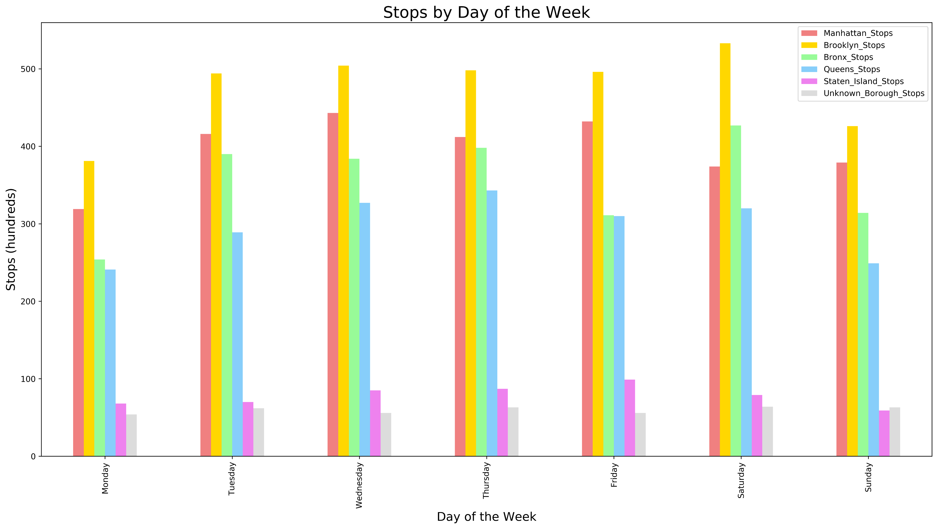
Presenter 4

Slide 19
Presenter 4

Slide 20
Presenter 4

Slide 21
